Slide 1

Smarter Work Zones
Duane Thomas, PE
FHWA – Resource Center
Operations Technical Services Team
August 15, 2019

Slide 2
Smarter Work Zones (SWZ)
Innovative strategies designed to optimize work zone safety and mobility
Policies and practices used to incrementally and continuously improve WZ operations
Tools to reduce WZ crashes and delays
Tools to enhance WZ management strategies

Slide 3
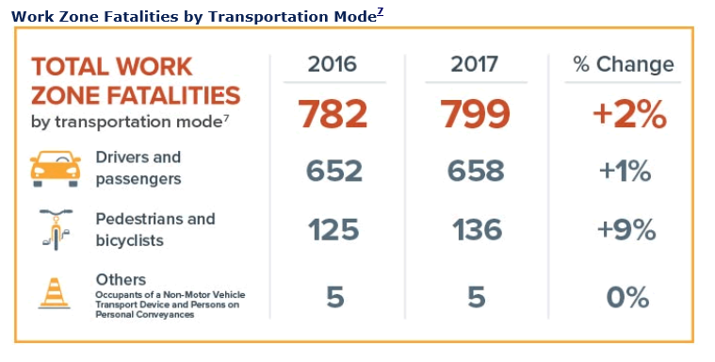
Negative Consequences of Work Zones
Source: Fatality Analysis Reporting System (FARS) 2016 Final and 2017 Annual Report File, National Highway Traffic Safety Administration (NHTSA).

Slide 4
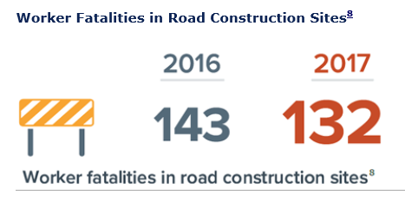
Negative Consequences of Work Zones
8 times higher than the rate of all workers
2 times the rate of other construction workers
Source: 2016 and 2017 U.S. Department of Labor, Bureau of Labor Statistics

Slide 5
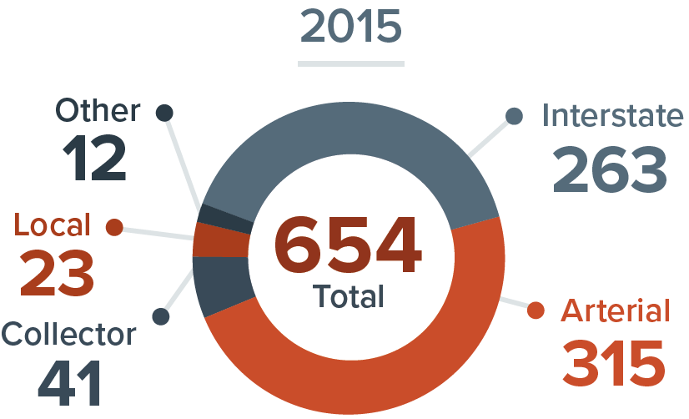
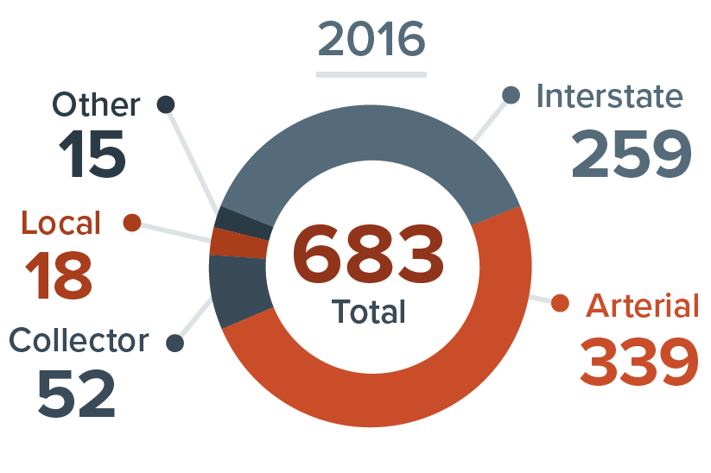
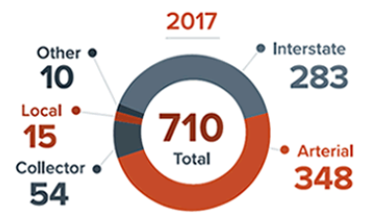
Negative Consequences of Work Zones
Source: Fatality Analysis Reporting System (FARS) 2015 and 2016 Final and 2017 Annual Report File, National Highway Traffic Safety Administration (NHTSA).

Slide 6
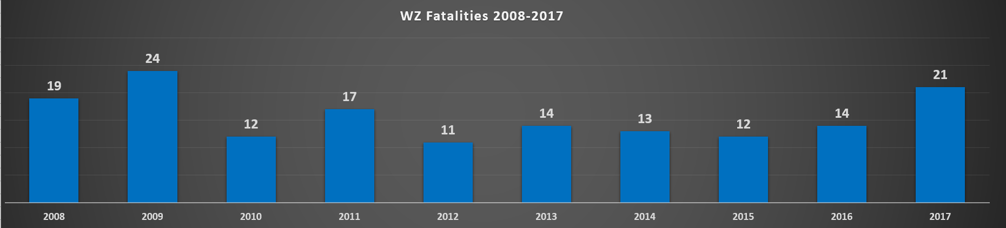
Negative Consequences of Work Zones
Arkansas WZ Fatalities
Ranked 10th in the US for 2017
Source: Fatality Analysis Reporting System (FARS), National Highway Traffic Safety Administration (NHTSA).

Slide 7
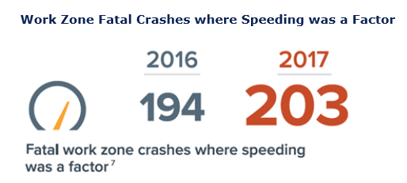
Negative Consequences of Work Zones
Source: Fatality Analysis Reporting System (FARS) 2016 Final and 2017 Annual Report File, National Highway Traffic Safety Administration (NHTSA).

Slide 8
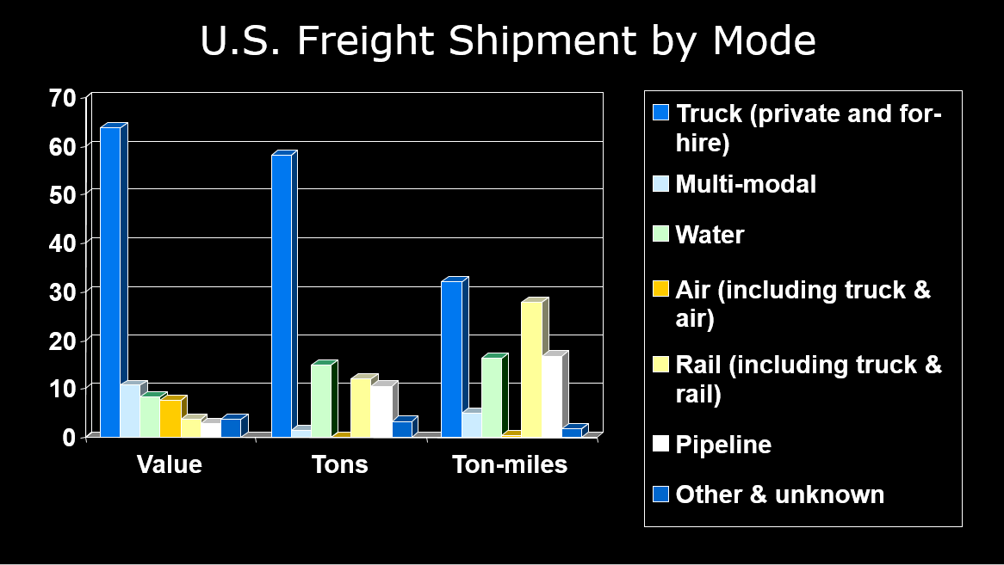

Slide 9
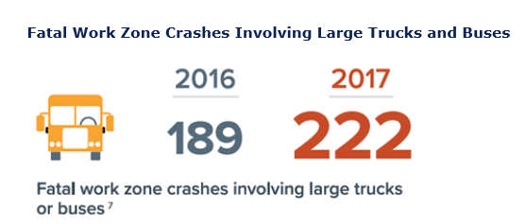
Negative Consequences of Work Zones
Source: Fatality Analysis Reporting System (FARS) 2016 Final and 2017 Annual Report File, National Highway Traffic Safety Administration (NHTSA).

Slide 10
Work Zones: Scope and Scale
Exposure: Part of the Driving Experience
Over 11 billion VMT through construction
  One active WZ encountered per 100 miles driven on the NHS, representing over 12 billion hours of vehicle exposure nationally; half involve lane closures
  Work Zone related mobility impact:
  10% (total congestion)
  25% (non-recurring congestion)

Slide 11
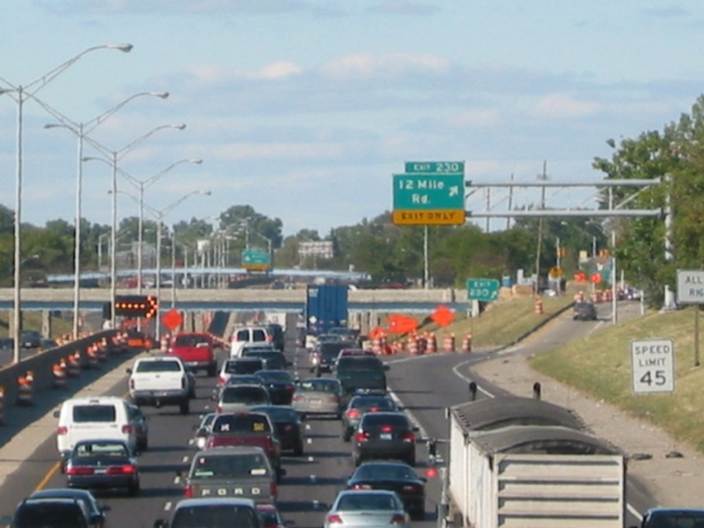
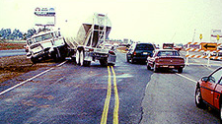

Can we do better?

Slide 12
SWZ Strategies
SWZ Initiative #1: Project Coordination
      Coordination within a single project and/or among multiple projects within a corridor, network, or region, and possibly across agency jurisdictions
      SWZ Initiative #2: Technology Application
      Deployment of Intelligent Transportation Systems (ITS) for dynamic management of work zone traffic impacts, such as queue and speed management

Slide 13
Smarter Work Zones
Project Coordination Examples

Slide 14
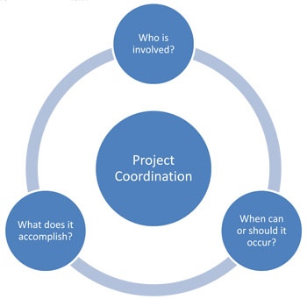
Project Coordination Guide
Organized by the five steps for achieving project coordination:
  Step 1: Establishing the Project Coordination Vision
  Step 2: Developing Details of How Coordination will Occur
  Step 3: Educating and Informing Personnel and Stakeholders
  Step 4: Implementing the Project Coordination Process
  Step 5: Refining the Process
  Publication FHWA-HOP-16-013
  Available in PDF only
https://ops.fhwa.dot.gov/wz/construction/crp/index.htm

Slide 15
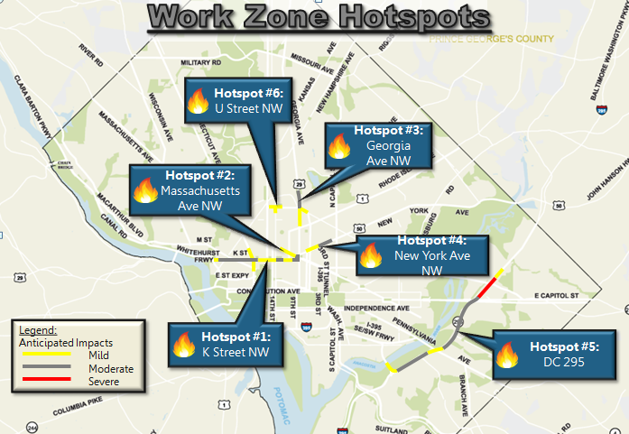
PC Strategy #1
Software to coordinate right-of-way construction activities
Baltimore, MD: Online mapping tool used to track capital and maintenance/utility activities
  Real-time information across city
  Accessible to all stakeholders
  Earlier awareness of project conflicts/impacts and enhanced TMPs
Washington, DC: WZ Project Management System
  System includes:
    DDOT, Developer, Utility WZ Projects
    Work Zone Tracking Tool
    Traffic Analysis Tool
  Used to develop annual citywide TMP
  Tracks performance measurement
Source: DDOT

Slide 16
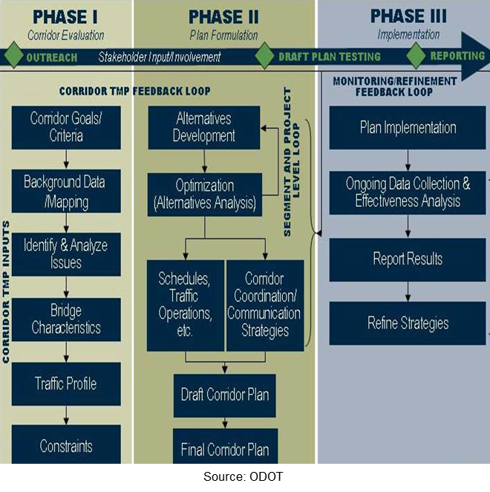
PC Strategy #2
Corridor-level TMPs to address traffic-related construction impacts
Oregon Transportation Investment Act
  Significant construction
  Six corridors identified
  Three levels of TMP
  Corridor-Level TMPs
    Assess corridor traffic impacts
    Define corridor/segment
    delay thresholds
    Suggest traffic mgmt. strategies
    Discuss implementation plan

Slide 17
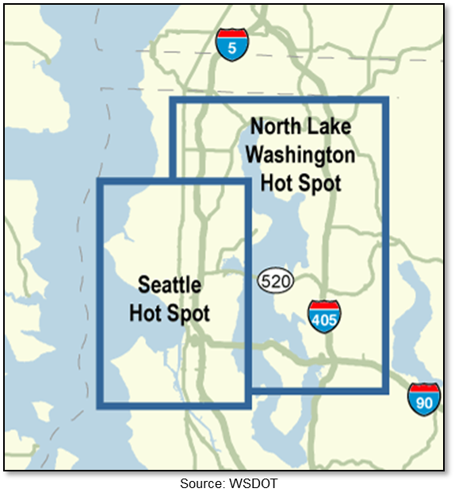
PC Strategy #3
Multi-agency construction traffic management activities
Washington State DOT
  Collaborative, multi-agency construction traffic planning effort
  Long-term, mid-term, and short-term information sharing
  Construction Impact Analysis Tool, Maps, Gantt Charts
  Hot Spots, Watch Lists

Slide 18
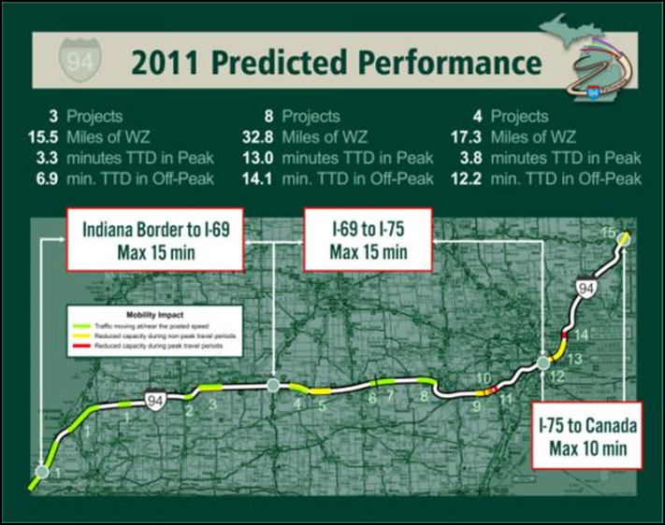
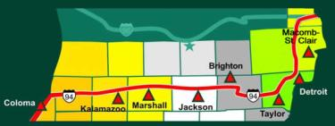
PC Strategy #4
Building partnerships to enhance mobility during construction
Michigan’s I-94 Corridor
  I-94 Corridor Operation Partnership (COP) Mission: “Improve traffic operations and system reliability along the I‐94 corridor statewide.”
  I-94 COP Objectives:
    Unification of I-94 corridor with one focus
    Travel Reliability: 40 min delay max for entire corridor

Slide 19
Smarter Work Zones
Technology Application Examples

Slide 20
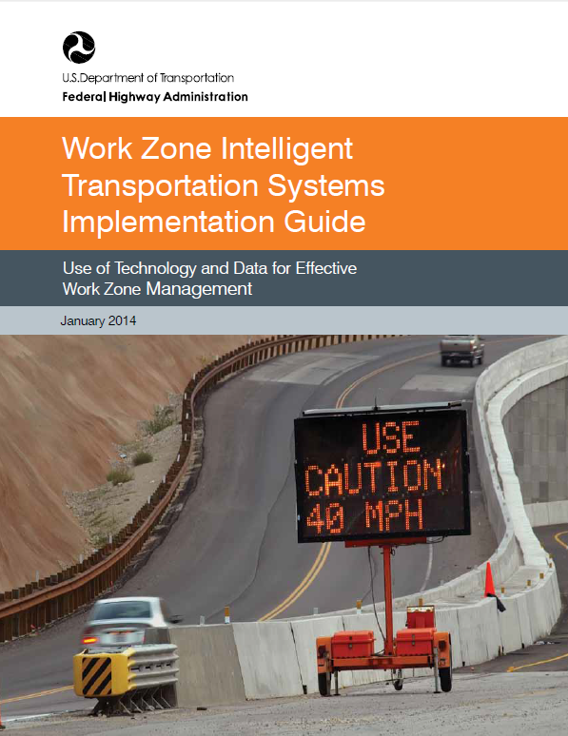
Work Zone ITS Implementation Guide
  Work Zone ITS Implementation Guide
  Publication FHWA-HOP-14-008
  Available in print & PDF
  ops.fhwa.dot.gov/publications/fhwahop14008/
  Work Zone ITS Case Studies
  Publication FHWA-HOP-14-007
  Available in PDF only
  ops.fhwa.dot.gov/publications/fhwahop14007/

Slide 21
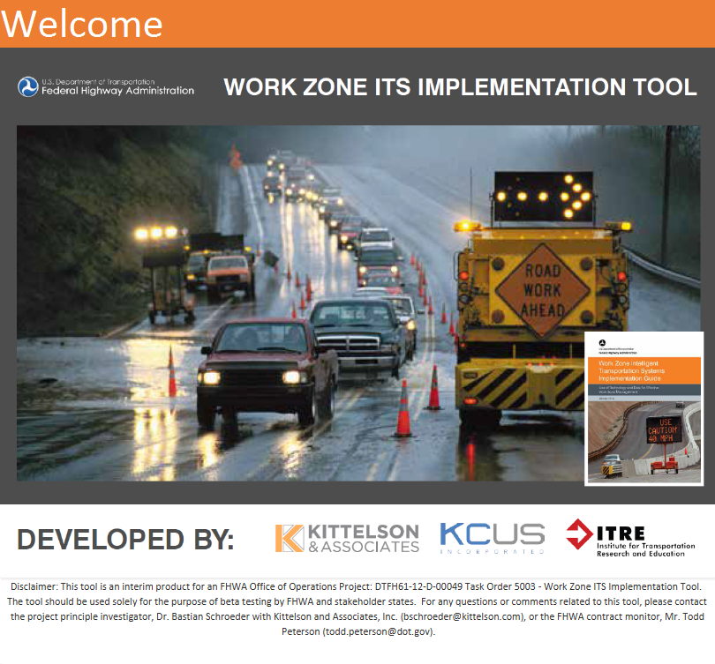
WZ ITS Implementation Tool
Software companion tool to the Guide to help bridge the gap between principles and practice
Follows logic and methodology descried in the Guide, extends its usefulness by leading the user through the process outlined in the guide

Slide 22
Primary Tool Functions
Technical Recommendations → Provide specific recommendation of what ITS technology to consider as a result of the inputs provided.
Project Management Tool → Guide the user through the various steps and sub-steps of the Guide and assist with data entry and general navigation of the WZITS process. The tool clearly establishes the sequence of decision-making, and facilitates use of the Guide.
Content Management Tool → Establish a record of decision-making and store interim information from the various steps in the guide, including listing of outputs, contact information for stakeholders, and records of decisions made along the way.

Slide 23
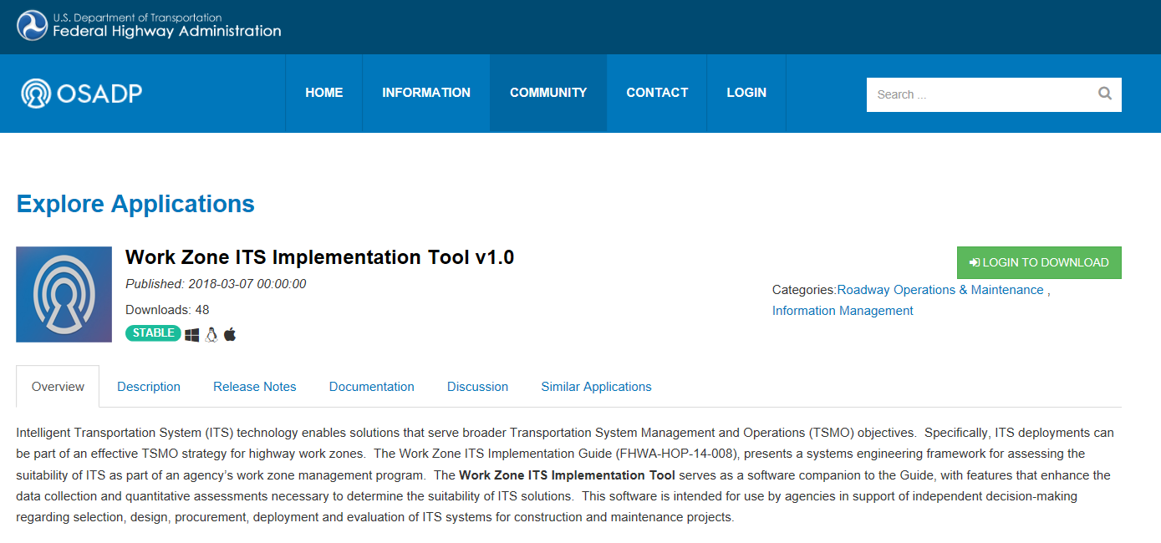
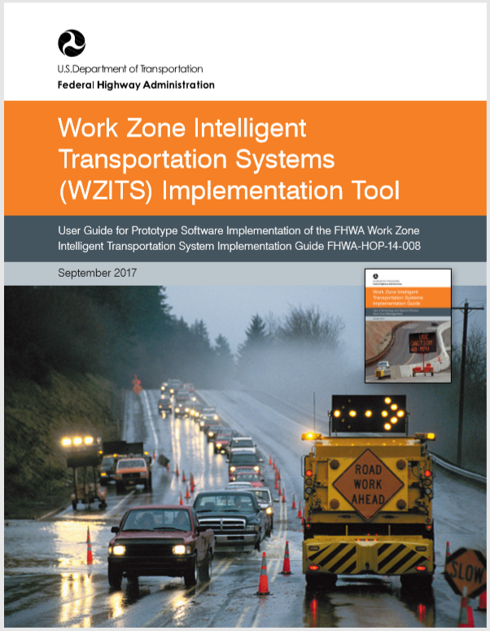
Obtaining the Tool
Download Tool and User Guide at https://itsforge.net/
  The Open Source Application Development Portal (OSADP) is a web-based portal that provides access to and supports the collaboration, development, and use of open-source intelligent transportation systems (ITS)-related applications

Slide 24
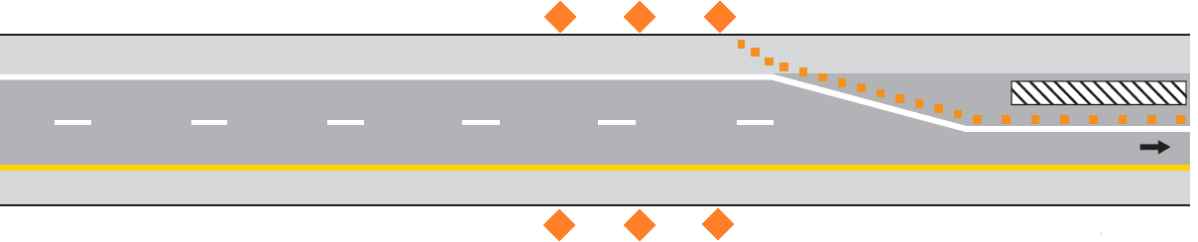

TA Strategy #1
Queue Warning System (QWS)
Zone of advanced work zone awareness provided by Queue Warning System
Warning Signs installed per TCP
Work Zone
STOPPED
TRAFFIC
2 MILES
data
Queue Warning Controller
Queue Detection Zone
PCMS

Slide 25
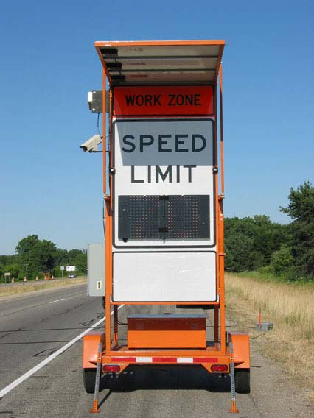
TA Strategy #2
Variable Speed Limits (VSL)
  Multiple speed trailers in & approaching work zone
  Each unit monitors prevailing speed-relays information to upstream units
  Posted speed limit dynamically adjusted to reduce downstream speed differentials

Slide 26
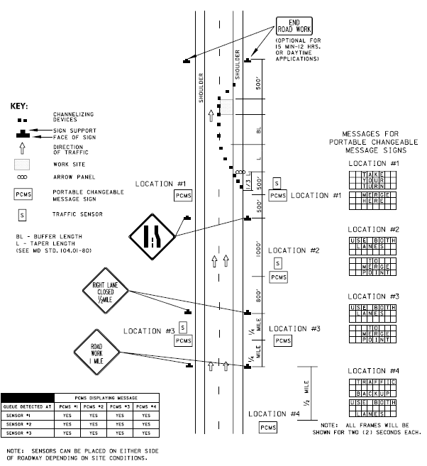
TA Strategy #3
Dynamic Lane Merge
Early Merge
  In low-volume conditions reduces the occurrence of high-speed merging at the point of lane closure
Late Merge
  In high-volume conditions reduces the length of the queue
Source: Maryland State Highway Administration

Slide 27
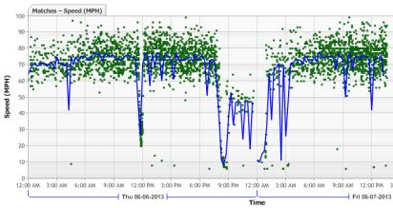
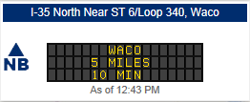
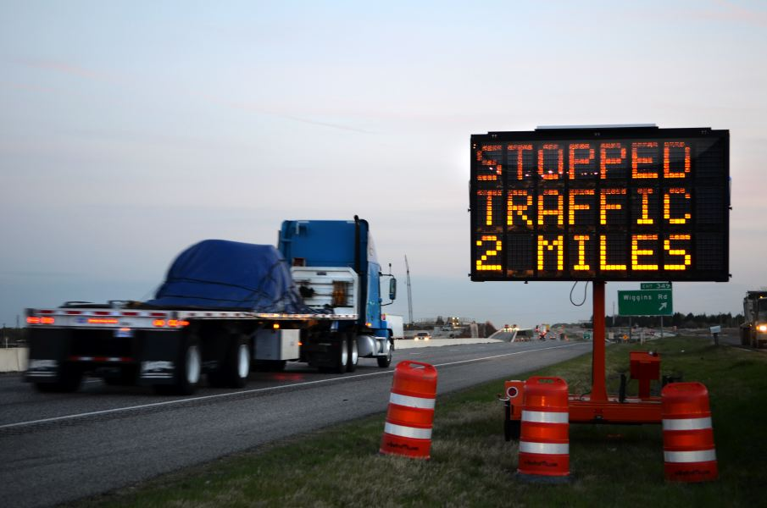
TA Case Study #1
I-35 Traveler Information During Construction
  Provide advance notification of planned lane closures and their anticipated impacts
  Provide travelers with predicted delays for construction closures (web app
  http://i35-maps.tti.tamu.edu/
  Provide real-time
  traveler information

Slide 28
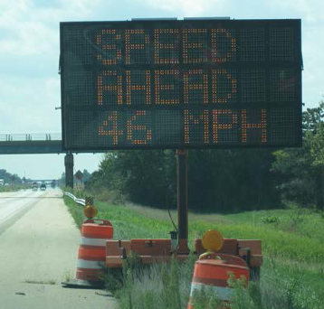
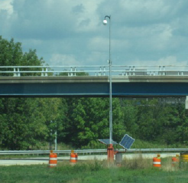
TA Case Study #2
Rural Queue Detection and Warning System
Central Illinois reconstruction projects used ITS for WZ rear-end crash concerns
  I-70/I-57 interchange, 6 mi of concurrent routes
  I-57/I-64 Interchange, 4 mi of concurrent routes
Key Concerns
  Unpredictable queues leading to severe rear-end crashes
  Lengthy delays when queues form
Solution Requirements
  Automatic detection of slow/queued traffic
  Ability to warn approaching motorists of slow/queued traffic
  Encourage diversion by informing motorists of current delays
FHWA
FHWA
Temporary, solar-powered system

Slide 29
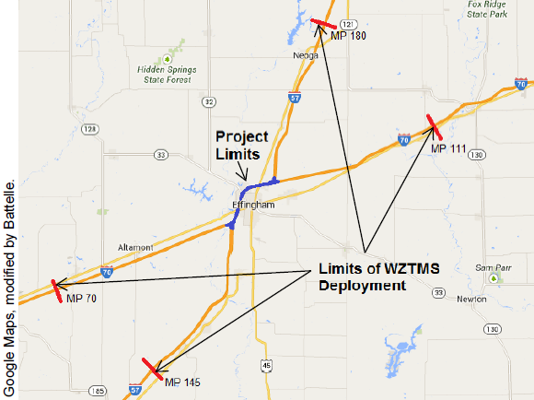
TA Case Study #2 (cont.)
Rural Queue Detection and Warning System
I-70/I-57 Interchange
  Portable solar-powered trailers:
    Radar sensors
    Traffic sensors
    Video surveillance cameras
  Traffic volume and speed data across multiple lanes of traffic
  Sensors not degraded by inclement weather conditions:
    Precipitation, fog, darkness, dust, or road debris
  Cellular communications
Limits of the I-70/I-57 WZTMS
(10-12 miles upstream in each direction)

Slide 30
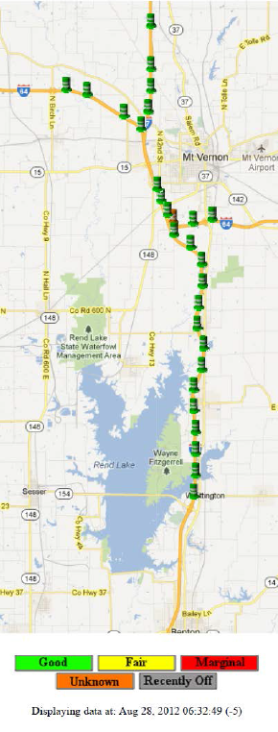
TA Case Study #2 (cont.)
Rural Queue Detection and Warning System
I-57/I-64 Interchange
  Portable traffic monitoring devices
  Self-contained, battery-powered unit with radar detector, GPS, cellular, and backup satellite communication capabilities and processors
  Sensors 3-14 miles upstream of interchange (depending on direction)
I-57/I64 Map layout of sensors

Slide 31
Resources

Slide 32
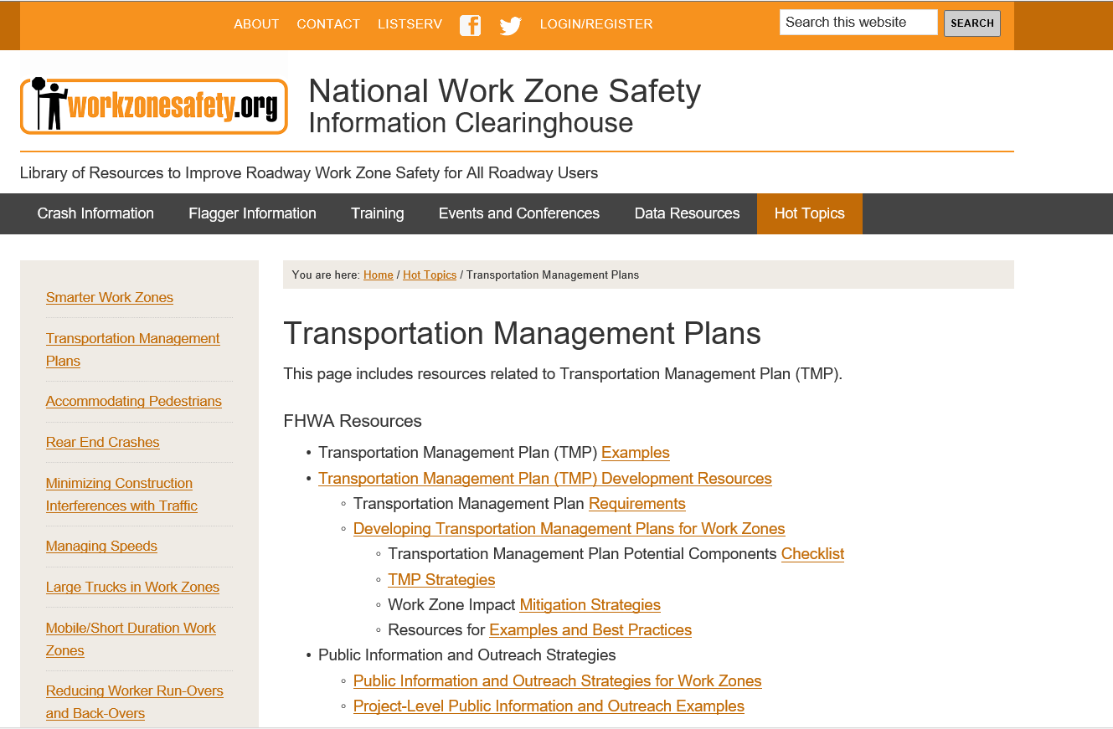
http://www.ops.fhwa.dot.gov/wz/resources/final_rule.htm

Slide 33
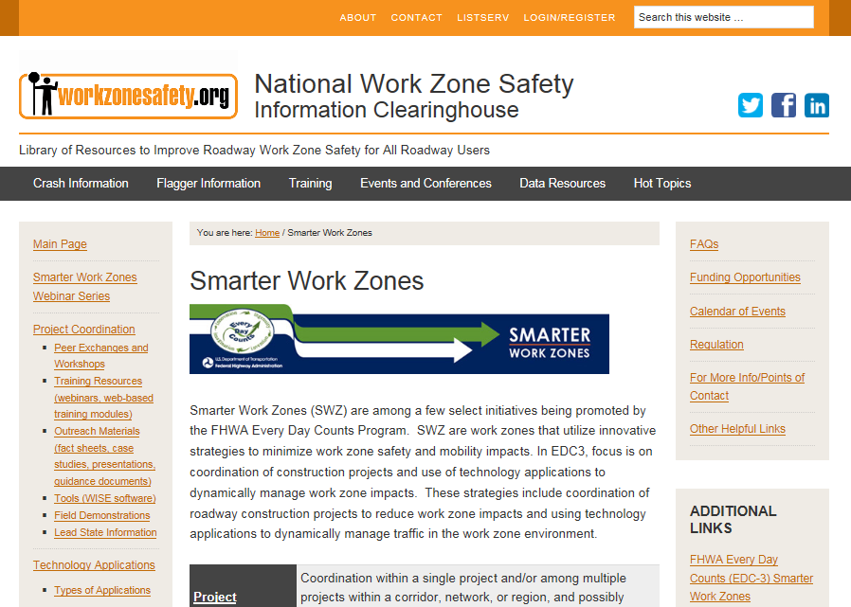
SWZ Interactive Toolkit
https://www.workzonesafety.org/swz/

Slide 34
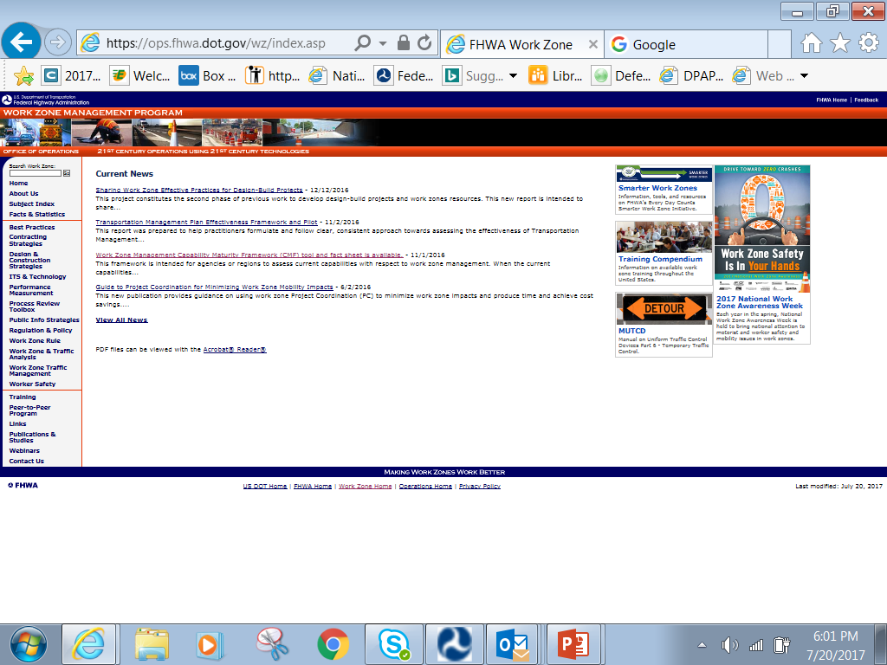
FHWA WZM Website

Slide 35
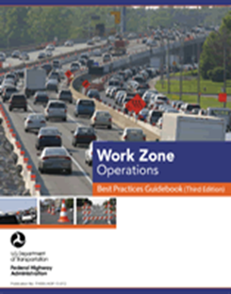
FHWA Work Zone Management Web Site
Facts & Statistics
Best Practices
Contracting Strategies
Design & Construction Strategies
ITS & Technology
Performance Measurement
WZ Process Review Toolbox
Public Info Strategies
Regulation & Policy
Work Zone Final Rules
Work Zone & Traffic Analysis
Work Zone Traffic Management
Worker Safety
Training
Peer-to-Peer Program
National WZ Awareness Week
Publications & Studies
35
https://ops.fhwa.dot.gov/wz/
Notes:
The FAQs are very helpful.

Slide 36
FWHA SWZ Support
  SWZ outreach materials
  Toolkit (online)
  Webinar recordings, case studies and fact sheets
  Learn more about SWZ strategies and deployments!
  Virtual and in-person training opportunities
  1-2 day in-person workshops
  Learn about SWZ concepts based on YOUR state needs!
  Virtual and in-person peer-to-peer exchanges
  Hosting and participant opportunities
  Regional Peer Exchange Workshops
  Hosting and participant opportunities
  Meet with agencies who have successfully adopted SWZ strategies!
  Demonstration Site Visits
  Hosting and participant opportunities
  See first-hand SWZ deployments across the country!

Slide 37
Contact Information
Duane Thomas, PE
FHWA – Resource Center
Operations Technical Services Team
Duane.Thomas@dot.gov

